Slide 1
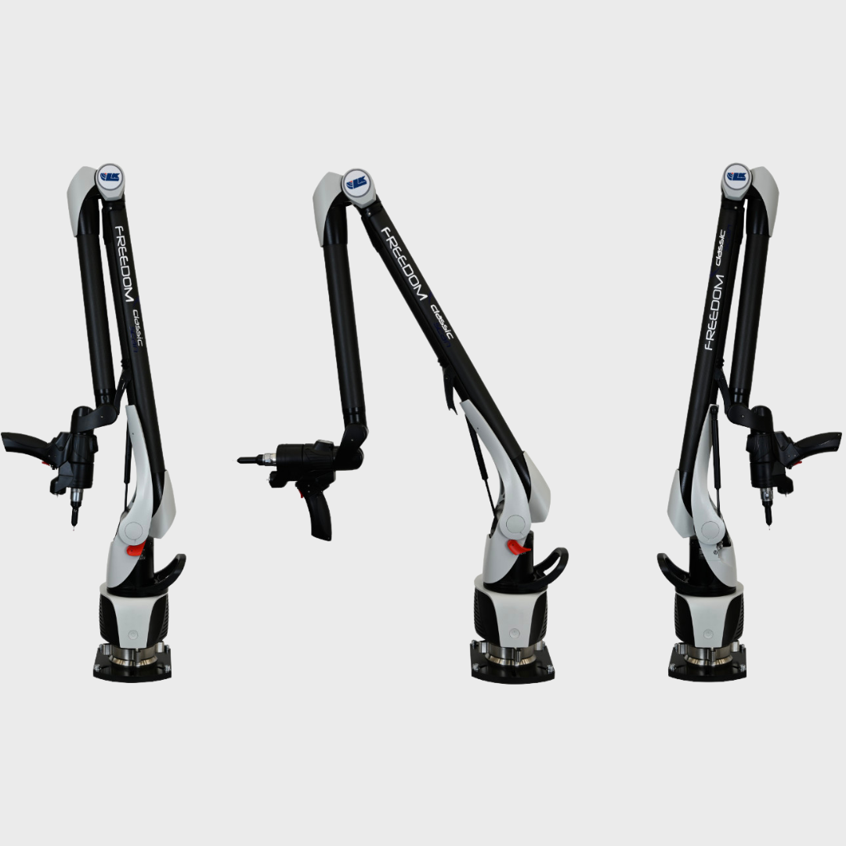
Week 4 Progress Meeting – L Matota
Revised Objectives:
To implement a joint design that will provide a holding torque that will keep the arm in place after support has been removed and that will not degrade overtime
To implement a joint design that will minimize run-out tolerance
To implement a joint design that is lightweight and compact
To make the joint design modular and applicable to a range of PCMAs

Slide 2
Scope: Limitation of the Project
A maximum of 3 of the most used models in industry will be modelled for analysis purposes
Any datasheets, reference and user manuals, will be used to provide information for the models
Three designs for a position-holding mechanism will be considered for concepts
Design evaluation will be conducted through a comparative analysis considering cost and time
The best design physically implemented and tested

